Slide 1
Video Game Network Analysis
Clarissa Franklin, Kyle Katzen,
Paige McKenzie, Meyappan Subbaiah

Slide 2
Project Overview
We scraped tweets over a 14-day period with mentions of three video games, produced by Paradox Interactive:
Europa Universalis IV (eu4)
Stellaris
Crusader Kings 2 (ck2)
These are games by the same developer with similar gameplay, and so may be appealing to the same customers.
We hoped to find the network of game players on Twitter, and identify influencers in the network who may be able to convince their followers to purchase an additional game or become a gamer.
Using this information, we could recommend Paradox Interactive target certain users to offer discount codes or free expansion packs, to influence a larger network to adopt one of the games.

Slide 3
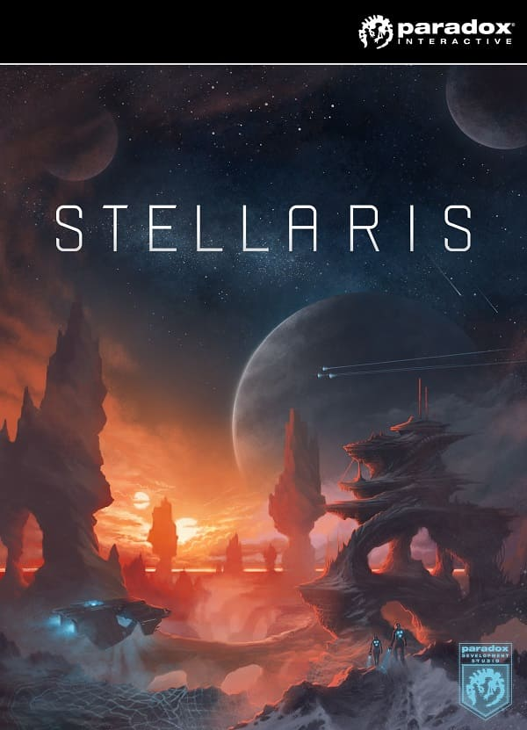
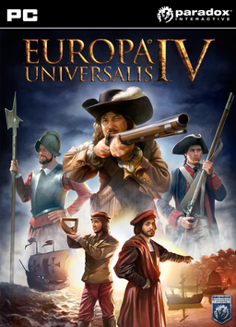

Paradox Interactive Games
Notes:
Official game descriptions:
Europa Universalis IV
Rule your nation through the centuries, with unparalleled freedom, depth and historical accuracy.
Crusader Kings II
Europe is in turmoil. The lands are fragmented into petty fiefs, the emperor struggles with the Pope, and the Holy Father declares that all those who go to liberate the Holy Land will be freed of their sins. Now is the time for greatness. Increase your lands and fill your coffers, appoint vassals, battle traitors, introduce laws while interacting with hundreds of nobles, and create the most powerful dynasty of medieval Europe. A beleaguered king will always have friends to support him. But beware, as your rule and realm may find trouble when a loyal vassal becomes a bitter rival. Stand ready, increase your prestige, and listen to the world whisper your name in awe. Do you have what it takes to become a Crusader King?
Stellaris Featuring deep strategic gameplay, a rich and enormously diverse selection of alien races and emergent storytelling, Stellaris has engaging challenging gameplay that rewards interstellar exploration as you traverse, discover, interact and learn more about the multitude of species you will encounter during your travels.

Slide 4
Game Market Overlap
From the official Stellaris website:
“Explore a vast galaxy full of wonder! Paradox Development Studio, makers of the Crusader Kings and Europa Universalis series presents Stellaris, an evolution of the grand strategy genre with space exploration at its core.”
Notes:
Paradox Interactive deliberately markets the Stellaris game to Crusader Kings and Europa Universalis audiences. According to an avid videogamer, the training barrier to enter a new game by Paradox Interactive is significantly lower if you already know how to play another game. For instance, it may require 10 hours of youtube videos to understand how to play Crusader Kings or Europa Universalis if you have no prior Paradox Interactive game experience. However, if you already know how to play Crusader Kings, it may only take you an additional 2 hours to learn how to play Europa Universalis. This means that customers who already play one or more Paradox Interactive games are more likely to have the time to invest in learning a new Paradox Interactive game that a customer who has never working on Paradox Interactive.

Slide 5
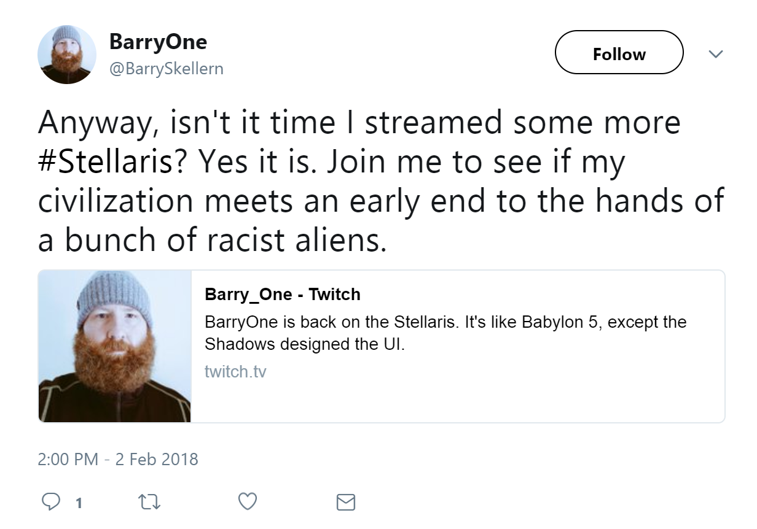
Approach
We scraped tweets from Sunday, 2/11 through Saturday, 2/24 with mentions of “stellaris”, “eu4”, and “ck2”.
Using these tweets, we constructed a directed network based on who tweeted at who.

Slide 6
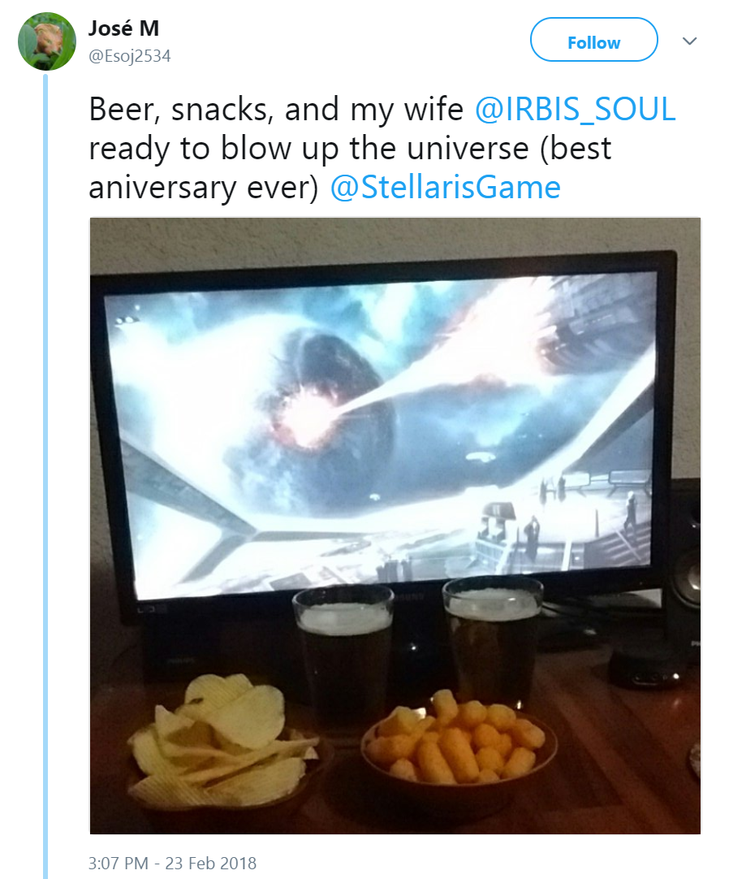
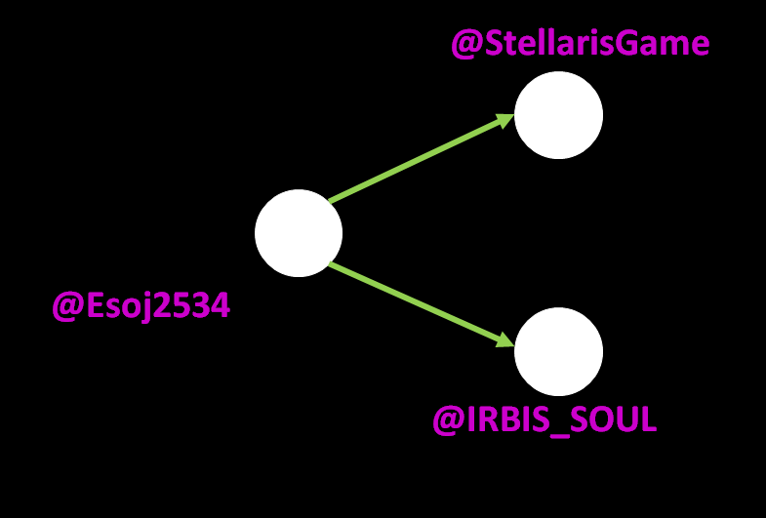
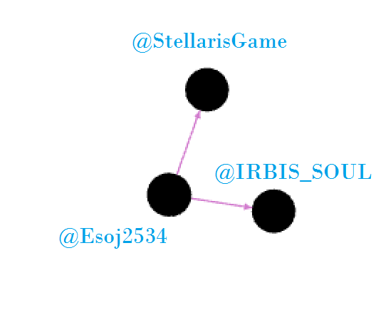
Example Tweet
Example Network

Slide 7
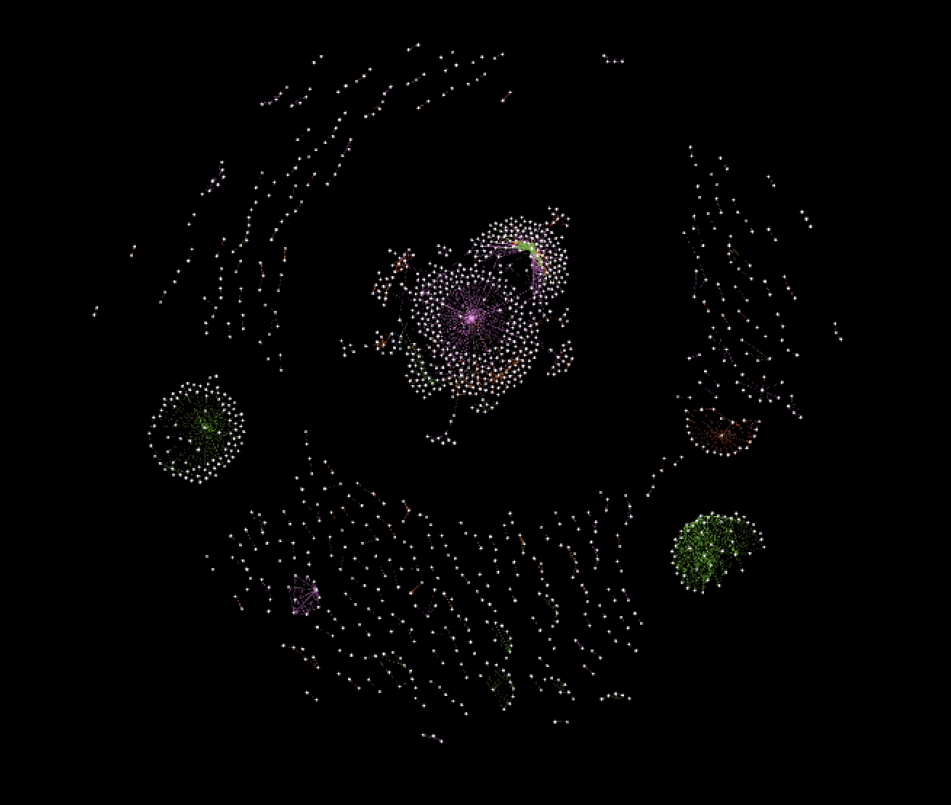
Overall Network
Stellaris
EU4
CK2
We can see a central group of highly concentrated activity, as well as a few satellite communities that seem highly interconnected, all surrounded by a scattering of individual conversations.

Slide 8
42.9% of conversations mention Stellaris
39.4% of conversations mention EU4
17.1% of conversations mention CK2

Slide 9
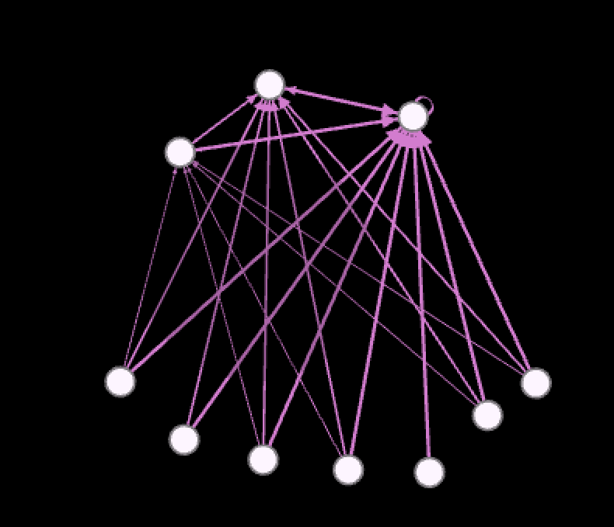
Sub-Networks
Stellaris
Due to how one-directional this network is, it would not be a prime candidate for Paradox to target.
Notes:
This network is both small and not very connected, as we can see a larger number of tweet originators towards the bottom of the network, who engage one-directionally with the three users towards the top, who do not reciprocate. Somewhat interestingly these three users interact with each other, perhaps indicating a small group that games together or hosts sessions on YouTube, and a wider network of fans who are trying to get attention from them. However, since these 3 influencers do not have a great track record of tweeting about Paradox’s games, we would not recommend Paradox try to recruit them.

Slide 10
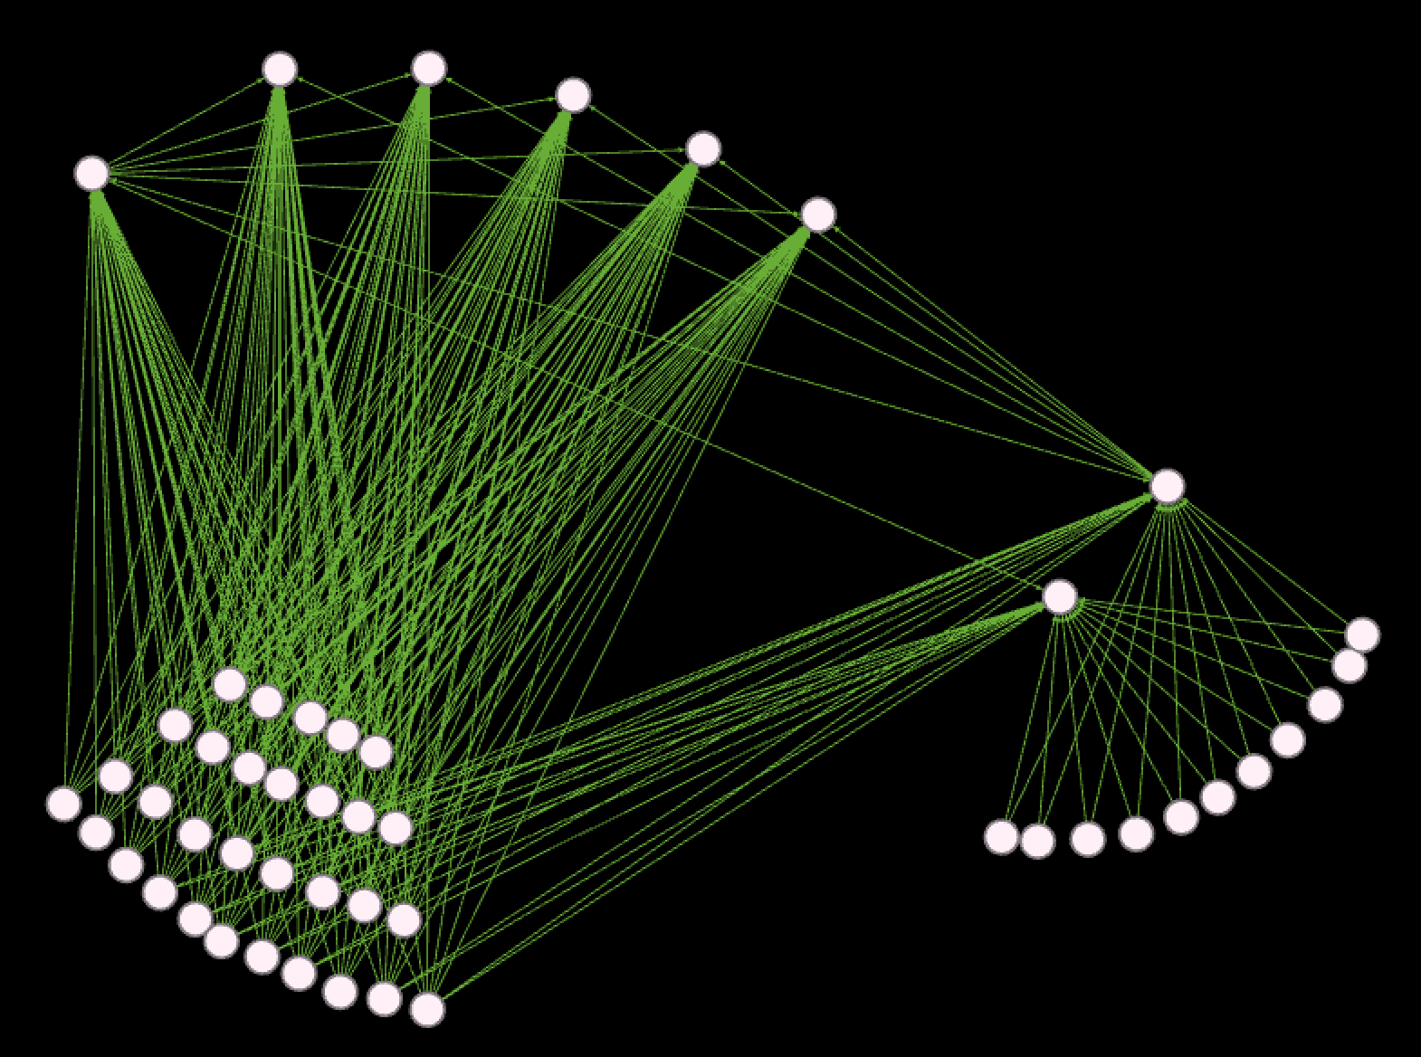
Sub-Networks
EU4 (1st cluster)
Compared to the other sub-networks, this is one of the most interconnected. This looks like a small community that if you could get a few of them to play CK2 or Stellaris would encourage their community to play with them.

Slide 11
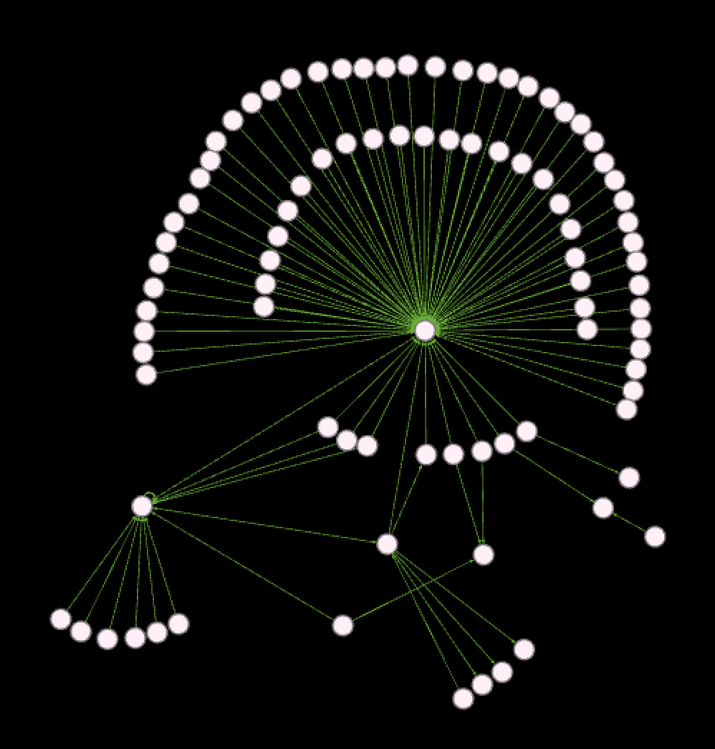
Sub-Networks
EU4 (2nd cluster)
This network shows a fairly influential person at the center of many nodes that haven’t interacted with very many other people.
Notes:
This network is primarily circled around @EnviousEra (the center of the circle), who got tweeted at by 75 other users about EU4 during the period we scraped.

Slide 12
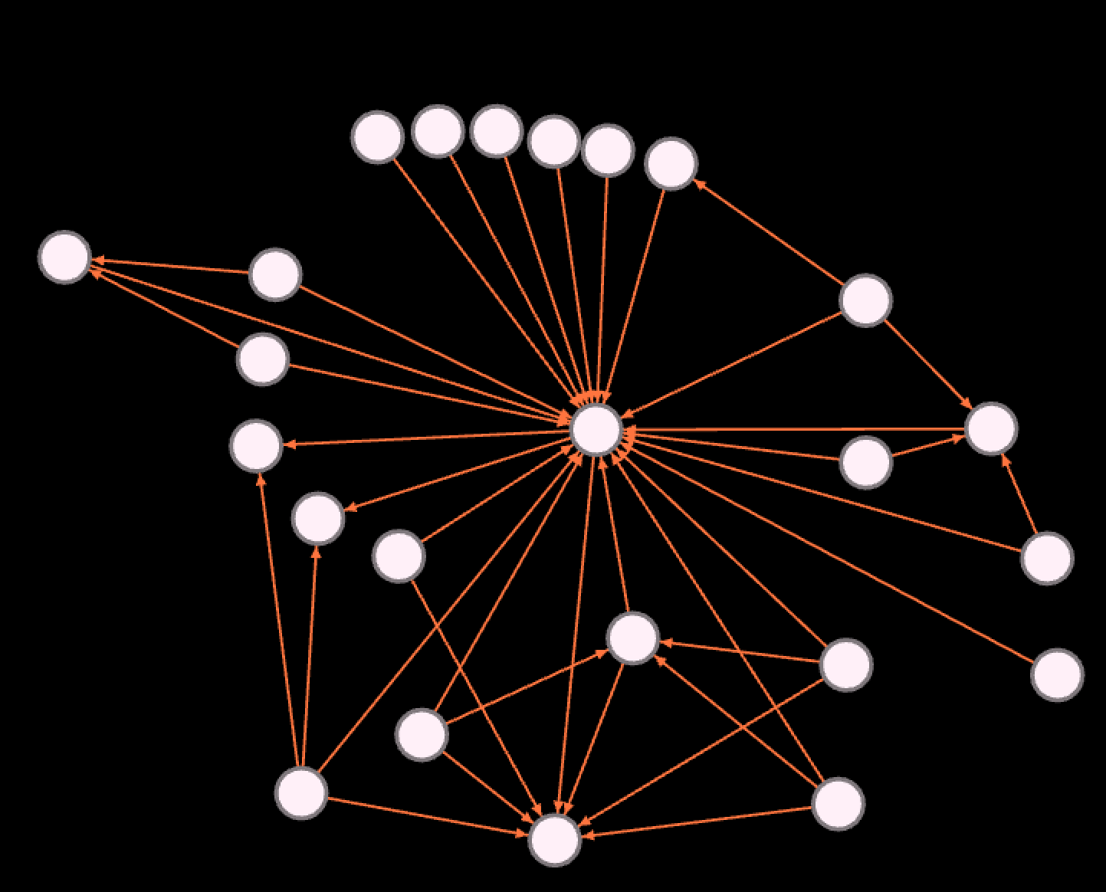
Sub-Networks
CK2
Conversely, this network of conversations about Crusader Kings II is a much better target due to the higher level of interconnectivity.
Notes:
@GreenBiz, the central node, interacts with every other person in the community, and receives tweets as well as sending them, unlike the previous subnetworks. Additionally, the satellite nodes also interact with each other, with several other users both sending and receiving tweets that mention Crusader Kings. Especially considering the short amount of time we were able to scrape, this indicates a highly involved network.
The clearest influencer to try to impact would be the central node, @GreenBiz, since he interacted with all the other users and has a large number of followers (96,213).

Slide 13
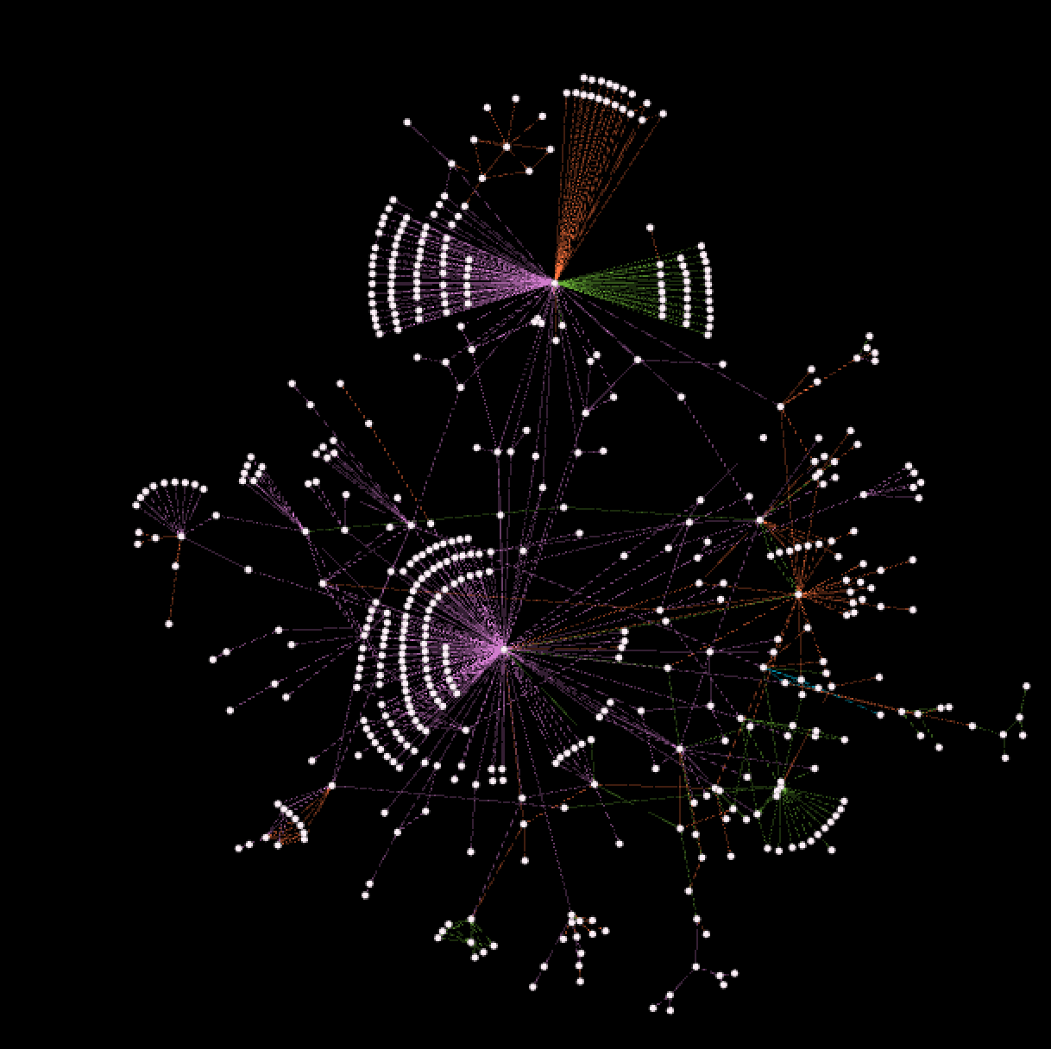
Sub-Networks
The Monster
This central mass centers around the official twitter handles of the games and the official Youtube twitter. These are people are often commenting on or retweeting official game news or are streamers that are tweeting about something they are doing with the games.
Notes:
As these people are already highly embedded in the community, through their connection to the official game handles (@Stellaris, etc) or to @YouTube, they are probably already aware of the other games Paradox offers. Someone like @E_Universalis would be a prime candidate to cross sell Stellaris or CK2, as he is an influencer to a large amount of activity for EU4.

Slide 14
Business Value
Studying networks allows Paradox to target specific influencers within individual game groups.
Can be done using high betweenness, or degree
These influencers can be suggested to promote similar games to their network
Some influencers are ‘youtube-ers’ and can be used as free advertising
Within densely connected networks all members can be given free games.
This would influence individuals to purchase expansions.
The expansions can cost upwards of $250 while the base games are only $40
Additionally, Paradox can target these users with specific discounts
Notes:
Use betweeness as a measure to identify a node that bridges with other nodes. A high B score suggests that this individual is an influencer in general for Paradox games, or for a specific game mentioned before.
These influencers can be leveraged to push Paradox’s agenda further. For example, a specific influencer for EU4 can be sent a free game for CK2. In hopes that the influencer would promote CK2 within their network (comprising mostly of nodes related to Eu4).
Densely connected networks signals that impact to one node will reverberate throughout the network. Therefore providing free games to the full network, will most likely cause for nodes to eventually be targeted for further expansions and discounts.

Slide 15
Determining who and how to target
Interconnected Clusters
Few Influencer Clusters

Slide 16
Determining who and how to target
 | Interconnected Cluster | Single Influencer Cluster
Average Degree | 4.860 | 1.099
Average Clustering Coefficient | .127 | .041
Average Path Length | 1.306 | 2.97
Diameter | 2 | 4
Notes:
These are the metrics that we’d use to inform us on what strategies we should take to influence a network cluster. The higher the clustering coefficient, the lower average path length, the lower the diameter, and the higher the average degree, the more we believe that strategies that take advantage of friends and network effects will work as opposed to giving an influencer perks or games.

Slide 17
Recommendations
Due to the low activity surrounding Crusader Kings II, Paradox should target clusters of activity on Twitter for Stellaris and EU4 to cross sell CK2.
In a highly interconnected network, such as the Stellaris cluster and 1st EU4 cluster, Paradox should offer several twitter users discount codes, so that they try the new game and get their communities involved as well.
However for the clusters centered around a few people, such as the 2nd EU4 cluster, it might be better to offer the influencers the game for free and expect that if they play it, they may talk about it or create content with it.
Lastly, for the large cluster centered around the official game/YouTube handles, it would be best to offer a limited number of discount codes to users in bridge positions to clusters of Stellaris/EU4 activity, as these users are probably aware of CK2 due to their connection to the larger network, but also offer influence on an already-proven customer base.

